Slide 1





A Data-Driven Analysis of Workers’ Earnings on Amazon Mechanical Turk
Kotaro Hara, Abigail Adams, Kristy Milland, Saiph Savage Chris Callison-Burch, Jeffrey P. Bigham
Kotaro Hara
Abigail Adams
Kristy Milland
Saiph Savage
Chris Callison-Burch
Jeffrey P. Bigham

Slide 2
A Data-Driven Analysis of Workers’ Earnings on Amazon Mechanical Turk
Kotaro Hara, Abigail Adams, Kristy Milland, Saiph Savage Chris Callison-Burch, Jeffrey P. Bigham
CHI 2018
Engage with CHI
Notes:
Thank you for coming to the presentation. Today, I am going to talk about “a data-driven analysis of workers’ earnings on Amazon Mechanical Turk.” This work was done in a collaboration with Abi Adams, Kristy Milland, Saiph Savage, Chris Callision-Burch, and Jeff Bigham.

Slide 3

600k
online workers and counting
The Hamilton Project (2015)
Notes:
A gig economy is transforming the way we work. In 2015, 600k people worked online and this number is increasing.
-- Note
WorldBank estimates that about 4.8 million active workers contributed to online crowdsourcing
-- Figure
Saeful Muslim, https://thenounproject.com/search/?q=male%20female&i=1258540

Slide 4

Online outsourcing industry generated
$2b
Hitlin (2016), WorldBank (2015)
Notes:
In 2013, online gig-economy, or crowdsourcing, generated two billion dollars. The economic significance of crowdsourcing is rising.
-- Figures
Figure created by Kirby Wu from the Noun Project

Slide 5
Are workers treated fairly? How does this new work style affect their lives?
!
Notes:
But at the same time, a number of researchers raised concerns about whether workers are treated fairly.

Slide 6
Martin et al. 2014; Berg 2016; Irani and Silberman 2016; Alkhatib et al. 2017
Notes:
The issue has been discussed in CHI as well as else where.

Slide 7
Workers earn a fraction of the U.S. minimum wage ($7.25/h)
$7.25/h
$5/h [Hitlin 2015]
$4.65/h [Berg 2016]
$1/h [Martin et al. 2015]
$0/h
Notes:
Particularly, they repeatedly point out that workers only earn a fraction of the U.S. minimum wage, which is $7.25/h. This is problematic given that 75% Mechanical Turk workers live in the U.S. and income generation is their primary goal

Slide 8
These figures are subjective data based on workers’ opinions on an online forum and survey responses
The lack of reward and task duration data has prevented us from objectively analysing workers’ hourly wage
$7.25/h
$5/h [Hitlin 2015]
$4.65/h [Berg 2016]
$1/h [Martin et al. 2015]
$0/h
Notes:
However, these figures from previous work have been calculated based on subjective data, which could be biased. The problem is that the lack of a large dataset of reward and task duration has prevented us from objectively analyzing workers’ hourly wage.

Slide 9

3.8m
task records
https://crowd-workers.com/
Notes:
To address this, we used the data collected through a Chrome plug-in called Crowd Workers. We collected 3.8 million task records from people who had this plug-in installed.

Slide 10
Research Questions
How much are workers earning on Amazon Mechanical Turk?
What contributes to the low wage?
Notes:
This data allows us to ask and quantitatively analyze two important questions “How much are workers earning on Amazon Mechanical Turk” and “What contributes to the low hourly wage.”
-- Figures
Figure created by Kirby Wu from the Noun Project

Slide 11
Research Questions
How much are workers earning on Amazon Mechanical Turk?
What contributes to the low wage?
Notes:
Let me start with the first research question.
-- Figures
Figure created by Kirby Wu from the Noun Project

Slide 12
Data
N=2,676 workers
Task description
title, keywords, description, task IDs, requester IDs, reward ($)
Task status
submitted vs. returned
Timestamps (task start, task end, task return)
Notes:
The data that we collected includes task description like title, keywords, description, task IDs, requester IDs, and reward, as well as task status like submitted vs returned and timestamps of task start, task end, task return.

Slide 13
Data
N=2,676 workers
Task description
title, keywords, description, task IDs, requester IDs, reward ($)
Task status
submitted vs. returned
Timestamps (task start, task end, task return)
These pieces of information enable us to calculate hourly wage
Notes:
Most important pieces of information are reward and timestamps, which allow us to calculate hourly wage.

Slide 14

It is surprisingly hard to get accurate estimation of hourly wage
Notes:
Let me describe how we calculated hourly wage using these pieces of information. But we found that it is surprisingly hard to get accurate estimation of hourly wage even with our data.
-- Figures
Royyan Wijaya

Slide 15
Hourly Wage Estimation (Naïve)
Task Start
Task End
Task Interval
Task Reward ($)
= Per-task Hourly Wage
Task Interval
Notes:
Probably the most naive way to calculate hourly wage is to measure the time it took to perform a task, and divide the reward by the task interval. This gives a per-task hourly wage.

Slide 16
Hourly Wage Estimation (Naïve)
Σ Task Reward ($)
= Per-worker Hourly Wage
Σ Task Interval
Worker
Naïve method of calculating hourly wage
Notes:
If we are interested in per-worker hourly wage, we can divide the total reward that a worker earned by total task interval. We call these naïve methods of calculating hourly wage

Slide 17
Hourly Wage Estimation (Naïve)
Σ Task Reward ($)
The naïve method may under- or over-estimate the hourly wage
= Per-worker Hourly Wage
Σ Task Interval
Worker
Naïve method of calculating hourly wage
Notes:
But using the naïve method may over- or under-estimate the hourly wage.

Slide 18
Wage Under-estimation
Interval₁
Interval₂
Worker
People could work on tasks concurrently
Notes:
Consider this case. A worker worked on a task, spending time interval 1. The worker worked on another task spending time interval 2. As illustrated here, people could, and indeed they do work on tasks concurrently.

Slide 19
Wage Under-estimation
Interval₁
Interval₂
Worker
Interval_{batch}
Interval_{batch} < Interval₁ + Interval₂
Notes:
Which makes the batched time interval smaller than the sum of interval 1 and interval 2.

Slide 20
Wage Under-estimation
This may cause naïve method to over-estimate work durations due to interval overlaps and under-estimate the hourly wage
Interval₁
Interval₂
Worker
Interval_{batch}
Interval_{batch} < Interval₁ + Interval₂
Notes:
This may cause naïve method to over-estimate work durations and under-estimate the hourly wage.

Slide 21
Wage Over-estimation
Interval₁
Interval₂
There could be a short gap between two tasks (e.g., time to search for a task)
Notes:
Let’s consider another case. A worker works on a task and spend interval 1. After a short gap, he or she works on another task.

Slide 22
Wage Over-estimation
Interval₁
Interval₂
Interval_{batch}
Interval_{batch} > Interval₁ + Interval₂
Notes:
This time, the batched interval is larger than the sum of interval 1 and interval 2.

Slide 23
Wage Over-estimation
The naïve method may under-estimate a work interval due to time between tasks and over-estimate the hourly wage
Interval₁
Interval₂
Interval_{batch}
Interval_{batch} > Interval₁ + Interval₂
Notes:
As a result, the naïve method may under-estimate a work interval due to time between task and over-estimate the hourly wage

Slide 24
Interval overlap
Time between tasks
Wage over- and under-estimation may affect the accuracy of hourly wage calculation
To reduce the effects of interval overlaps and time between tasks, we used a temporal clustering method to compute hourly wage
Notes:
Wage over- and under-estimation may affect the accuracy of hourly wage calculation. To reduce the effects of interval overlaps and time between tasks, we used a temporal clustering method

Slide 25
Temporal Clustering
Task 1
Task 2
Task 3
Task 4
Notes:
Let me explain this. Let’s look at an example. Say, a worker worked on Task 1, Task 2, Task 3, and Task 4.

Slide 26
Temporal Clustering
Task 1
Task 2
Task 3
Task 4
We want to cluster temporally close tasks together to ignore this small gap
Notes:
We want to cluster temporally close tasks together to ignore this small gap.

Slide 27
Temporal Clustering
Task 1
Task 2
Task 3
Task 4
While keeping this isolated task disjoint
Notes:
While keeping this isolated task disjoint.

Slide 28
Temporal Clustering
Task 1
Task 2
Task 3
Task 4
d₁
d₂
Notes:
To do this, we focus on distances between segments

Slide 29
Temporal Clustering
Task 1
Task 2
Task 3
D
Task 4
D
If d_{k} is smaller than D,
d₁
d₂
Notes:
We introduce a constant capital D. If a distance is smaller than this constant capital D, then…

Slide 30
Temporal Clustering
Task 1
Task 2
Task 3
D
Task 4
D
If d_{k} is smaller than D, we group the time intervals together,
d₁
d₂
Notes:
We group the time intervals together

Slide 31
Temporal Clustering
Task 1
Task 2
Task 3
D
Task 4
D
If d_{k} is smaller than D, we group the time intervals together, and otherwise keep them disjoint
d₁
d₂
Notes:
Otherwise, keep them disjoint

Slide 32
Temporal Clustering: Cluster-based Hourly Wage
Task 1
Task 2
Task 3
Task 4
T_{cluster}
Notes:
Now we can use the cluster interval…

Slide 33
Temporal Clustering: Cluster-based Hourly Wage
Task 1
$₁
Task 2
$₂
Task 3
$₃
Task 4
T_{cluster}
Notes:
And a cluster reward, which is a sum of all the rewards from the tasks in the cluster

Slide 34
Temporal Clustering: Cluster-based Hourly Wage
Task 1
$₁
Task 2
$₂
Task 3
$₃
Task 4
T_{cluster}
Notes:
And a cluster reward, which is a sum of all the rewards from the tasks in the cluster

Slide 35
Temporal Clustering: Cluster-based Hourly Wage
Task 1
$_{cluster}
Task 2
Task 3
Task 4
T_{cluster}
We define per-cluster hourly wage as $_{cluster} / T_{cluster}
Notes:
To calculate per-cluster hourly wage

Slide 36
Temporal Clustering: Cluster-based Hourly Wage
Σ Cluster Reward ($)
Per-worker Hourly Wage with Clustering
=
Σ Cluster Interval
Worker
Because different choice of D yield different sets of clusters, we use D=0 and D=1 minute and see their effects on cluster-based hourly wages
Notes:
And if we are interested in per-worker hourly wage based on the clustering method, we can sum up cluster rewards and divide it by total cluster interval. Because different choice of the capital D yield different sets of clusters, we used D=0 and D=1

Slide 37
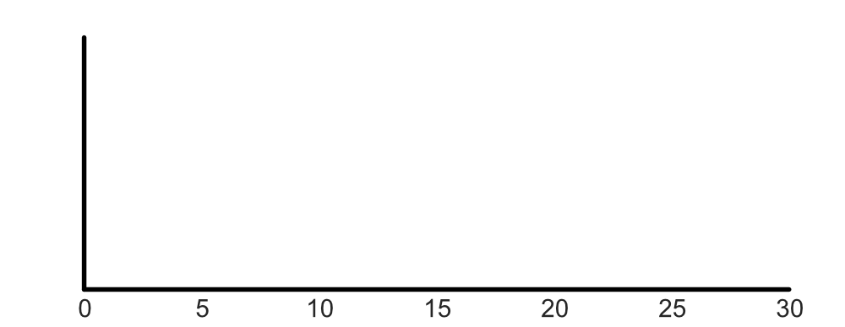
Worker Hourly Wage: Result (Naïve)
Density
Per-worker Hourly Wage ($/h)
Notes:
Let me show you the hourly wage distribution, calculated by using both naïve method and cluster-based method. Here, x-axis is per-worker hourly wage and y-axis is a density.

Slide 38
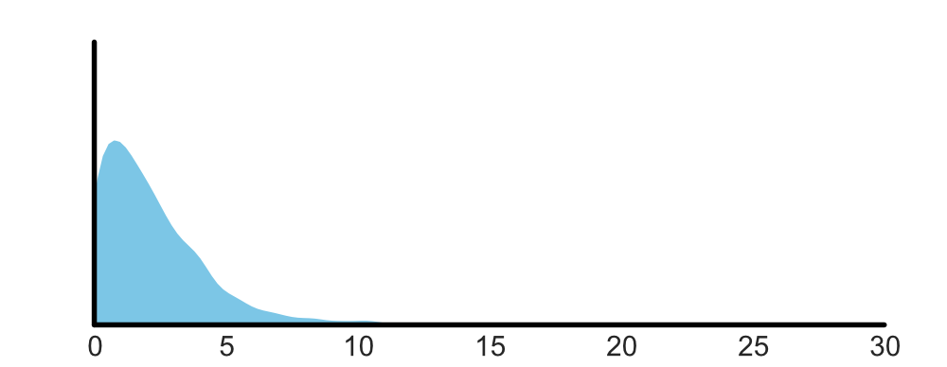
Worker Hourly Wage: Result (Naïve)
Density
Naïve
Per-worker Hourly Wage ($/h)
Notes:
Here is the distribution of hourly wage calculated by the naive method

Slide 39

Worker Hourly Wage: Result (Naïve)
Median hourly wage = $1.77/h
Density
Naïve
Per-worker Hourly Wage ($/h)
Notes:
The median hourly wage is $1.77/h

Slide 40

Worker Hourly Wage: Result (Clustered)
The wage distribution becomes more flat (median = $2.11/h).
Density
Naïve
D=0
Per-worker Hourly Wage ($/h)
Notes:
Let’s compare this to the distribution of the hourly wage with the D0 clustering. As you can see, the distribution becomes slightly more flat as a result of reducing the effect of interval overlap. The median hourly wage is pushed up to $2.11.

Slide 41

Worker Hourly Wage: Result (Clustered)
The D=1 wage distribution is more flat compared to the naïve distribution but peakier compared to D=0. D=1 median is $1.99/h
Density
Naïve
D=0
D=1
Per-worker Hourly Wage ($/h)
Notes:
The hourly wage distribution calculated by cluster-based method with D=1 minute is more flat compared to the naïve distribution but peakier compared to the D=0 distribution. This is because we take into account of gaps between tasks. Median hourly wage is 1.99.

Slide 42
Worker Hourly Wage: Result
Median worker hourly wage is around $2/h. Naïve estimation method under-estimates the hourly wage by approximately 12% (compared to D=1).
Density
Naïve
D=0
D=1
Per-worker Hourly Wage ($/h)
Notes:
What you can take from this analysis is that the median worker hourly wage is around $2/h regardless of the method. Although the naïve estimation method under-estimates the hourly wage by 12%, it is not too off.

Slide 43
Takeaway 1
The majority of workers on Amazon Mechanical Turk work with hourly wage below $2/h

Slide 44
Research Questions
How much are workers earning on Amazon Mechanical Turk?
What contributes to the low wage?
Notes:
-- Figures
Figure created by Kirby Wu from the Noun Project

Slide 45
Research Questions
How much are workers earning on Amazon Mechanical Turk?
What contributes to the low wage?
Notes:
Now we know that the workers are under-paid, let me explain why they are earning so little.
-- Figures
Figure created by Kirby Wu from the Noun Project

Slide 46

What contributes to the low wage?
$
¢
Unpaid work
Low reward
Requesters
Qualifications
Task types
Notes:
In this paper, we explored a variety of factors that may affect the hourly wage, including the effects of unpaid work, low task reward, presence of unfair requesters, qualifications, and work types.
-- Image
Creative Stall from Noun Project

Slide 47
What contributes to the low wage?
$
¢
Unpaid work
Low reward
Requesters
Qualifications
Task types
Notes:
But in this presentation, I will only discuss about the effects of unpaid work and requesters.
-- Image
Creative Stall from Noun Project

Slide 48
What contributes to the low wage?
$
¢
Unpaid work
Low reward
Requesters
Qualifications
Task types
Notes:
We’ll start with the unpaid work.
-- Image
Creative Stall from Noun Project

Slide 49
“
[…] aspects of turking [(working on Amazon Mechanical Turk)] like simply searching for jobs can take a considerable amount time.
The time spent learning and searching are clear examples of invisible [(unpaid)] work that Turkers must engage in […].
”
Martin et al., (2014) Being a Turker, CSCW 2014
Notes:
Let me quote the prior work to explain what I mean by unpaid work.

Slide 50
The issue of unpaid work has been identified in prior work, but its effects are not quantified
Notes:
The issue of unpaid work was previously pointed out, but its effects are not quantified.

Slide 51
We quantify three types of unpaid work
Reject
Returned
Time spent on returned tasks
Time spent on rejected tasks
Time between tasks
Notes:
In this paper, we quantified three types of unpaid work: time spent on returned tasks, time spent on rejected tasks, and time between tasks

Slide 52
We quantify three types of unpaid work
Reject
Returned
Time spent on returned tasks
Time spent on rejected tasks
Time between tasks
Notes:
Let me start with the returned tasks.

Slide 53
Task Submit and Return
Submit
Worker
Notes:
When a worker works on a task, two things could happen. He or she could complete the task and submit it.

Slide 54
Task Submit and Return
Reward will not be paid and so the time spent is wasted
Returned
Worker
Notes:
Or, if for some reason they cannot finish it, they will return the task. In this case, reward will not be paid.

Slide 55
Time Spent on Returned Tasks
Submitted
Returned
Σ
Σ
Returned
Time_{submitted}
Time_{returned}
For all tasks from all workers
Notes:
To understand the impact of returned tasks, we calculated the total time spent on submitted tasks and returned tasks.

Slide 56
Time Spent on Returned Tasks: Result
Submitted
Returned
Σ
Σ
Returned
Time_{submitted}
Time_{returned}
= 98,202 hours (68.2%)
= 45,778 hours (31.8%)
Notes:
We observed that about 98k hours were spent on the submitted tasks and 46k hours were spent on returned tasks. This means that 31.8% of time is wasted due to task return.

Slide 57
We quantify three types of unpaid work
Reject
Returned
Time spent on returned tasks
Time spent on rejected tasks
Time between tasks
Notes:
Moving on to rejected tasks.

Slide 58
Task Accept and Reject
Accept
Worker
Notes:
Once a worker submits a task, two things can happen. First, a requester agrees to pay the reward.

Slide 59
Task Accept and Reject
Reject
Worker
Notes:
Or the requester reject the task and refuses to pay the reward.

Slide 60
Time Spent on Rejected Tasks
We had data on task accept vs. reject status for 29.6% of the submitted tasks
Accepted
Rejected
Accept
Reject
Σ
Σ
Time_{accepted}
Time_{rejected}
Notes:
We had data on task accept vs. reject for 29.6% of the submitted task records. Using this data, we again calculated the time spent on the accepted tasks and rejected tasks.

Slide 61
Time Spent on Rejected Tasks: Result
We had data on task accept vs. reject status for 29.6% of the submitted tasks
Accepted
Rejected
Accept
Reject
Σ
Σ
Time_{accepted}
Time_{rejected}
= 33,130 hours (99.3%)
= 240 hours (0.7%)
Notes:
We observed that 33k hours were spent on the accepted tasks, and 240 hours were spent on the rejected tasks.

Slide 62
We quantify three types of unpaid work
Reject
Returned
Time spent on returned tasks
Time spent on rejected tasks
Time between tasks
Notes:
Finally, let’s look at time between the tasks.

Slide 63
Time Between Tasks
Worker
We want to know the effect of this small gap between tasks (e.g., task search time)
Notes:
We wanted to know how much time was wasted because of this gap between tasks.

Slide 64
Time Between Tasks
Clustering (D=1min)
Worker
Clustering (D=0min)
Σ
Δ
Notes:
To do this, we compare the difference in clustered task intervals. We cluster tasks using D=1 min and D=0. By subtracting the time, we get the difference in the interval, delta. We sum up all the delta to see the total time between the tasks.

Slide 65
Time Between Tasks: Result
Clustering (D=1min)
Worker
Clustering (D=0min)
Σ
= 4,603 hours
Δ

Slide 66
Result
45,778 hours
31.8% of work
240 hours
0.7% of work
4,603 hours
4.7% of work
Reject
Returned
Notes:
This is the overall result.

Slide 67
Takeaway 2
Returning tasks has the biggest impact on the hourly wage. In fact, 31.8% of work time is wasted due to this unpaid work.

Slide 68
What contributes to the low wage?
$
¢
Unpaid work
Low reward
Requesters
Qualifications
Task types
Notes:
Now, we investigate the requesters payment behaviors.
-- Image
Creative Stall from Noun Project

Slide 69
What contributes to the low wage?
$
¢
Unpaid work
Low reward
Requesters
Qualifications
Task types
Notes:
Now, we investigate the requesters payment behaviors.
-- Image
Creative Stall from Noun Project

Slide 70
Workers are underpaid. Is this because all requesters treat workers unfairly, or are there are small number of people who request very low paid tasks?
< $2/h
Notes:
We saw that the majority of workers are underpaid. It is not clear if this is because a few people are underpaying or all the requesters are underpaying.

Slide 71
Workers are underpaid. Is this because all requesters treat workers unfairly, or are there are small number of people who request very low paid tasks?
< $2/h
Notes:
We already saw that the majority of workers are underpaid. It is not clear if this is because a few people are underpaying or all the requesters are underpaying.

Slide 72
Workers are underpaid. Is this because all requesters treat workers unfairly, or are there a small number of requesters who post many very low paid tasks?
< $2/h
Notes:
We already saw that the majority of workers are underpaid. It is not clear if this is because a few people are underpaying or all the requesters are underpaying.

Slide 73
We investigated the distribution of per-requester hourly payment
Notes:
We investigate the distribution of per-requester hourly payment.

Slide 74
Per-requester Hourly Payment
$
$
Requester
$
Σ
$
$
$
$
Workers
Notes:
Let’s see how we calculated the per-requester hourly payment. A requester requests tasks to be completed multiple workers. These workers work on multiple tasks.
--Image
Saeful Muslim

Slide 75
Per-requester Hourly Payment
$
$
Requester
$
Σ
$
$
$
$
Workers
Notes:
To calculate the per-requester hourly payment, we sum up task intervals and rewards.
--Image
Saeful Muslim

Slide 76
Per-requester Hourly Payment
Σ Task Payment ($)
Requester
Per-requester Hourly Payment
=
Σ Task Interval
Workers
Notes:
To calculate the per-requester hourly payment, we sum up task intervals and rewards. Then, we divide the total task payment by the total task interval to get per-requester hourly payment for this requester.
--Image
Saeful Muslim

Slide 77
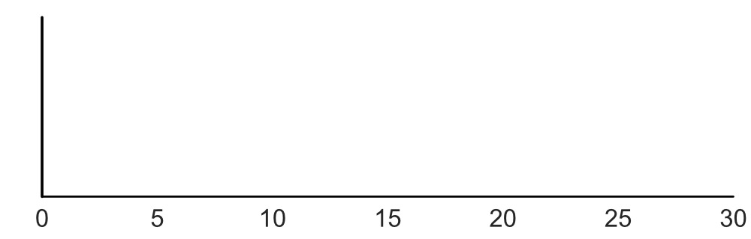
Per-requester Hourly Payment: Result
Density
Per-requester Hourly Payment ($/h)
N=19,598 requesters
Notes:
Let’s look at the distribution of the hourly payment. X-axis is per-requester hourly payment, and y-axis is density.

Slide 78
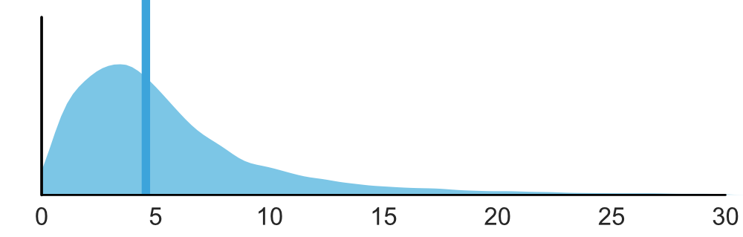
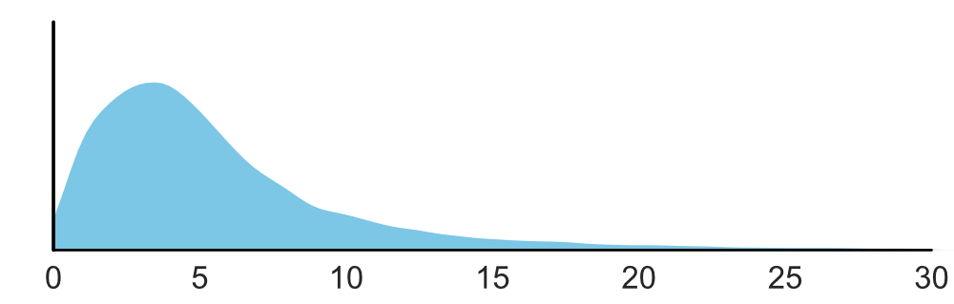
Per-requester Hourly Payment: Result
Median=$4.57/h
Density
Per-requester Hourly Payment ($/h)
N=19,598 requesters
Notes:
Here is the distribution of the per-requester hourly payment. The median payment is $4.57/h.

Slide 79
Takeaway 3
About half of the requesters pay below $5/h, which is below the U.S. federal minimum wage.
Notes:
Unfortunately, about half of the requesters pay below $5/h, which is below the U.S. federal minimum wage.

Slide 80
Takeaways
< $2/h
Crowd workers are underpaid and they often earn below $2/h
$
Unpaid work, particularly returning tasks has a large impact on the hourly wage
Majority of the requesters reward workers below $5/h

Slide 81
Discussion and Future Work
Could we create tools for workers to make it easier to search for tasks that give them good wage, avoid tasks that are not completable, and find requesters fair wage?
Could we create technologies for requesters to help them pay fairly?

Slide 82

Discussion and Future Work
How can we nudge more people to pledge and help them keep committing to their promises?

Slide 83
Limitations
Sampling bias
Our analyses did not take bonus payment into account
No information about demographics

Slide 84
A Data-Driven Analysis of Workers’ Earnings on Amazon Mechanical Turk
Kotaro Hara, Abigail Adams, Kristy Milland, Saiph Savage Chris Callison-Burch, Jeffrey P. Bigham
The Economic and Social Research Council, Grant ES/N017099/1
We thank the workers who provided the work log data that enabled this research
Image credits to Saeful Muslim, Kirby Wu from the Noun Project

Slide 85
A Data-Driven Analysis of Workers’ Earnings on Amazon Mechanical Turk
Kotaro Hara, Abigail Adams, Kristy Milland, Saiph Savage Chris Callison-Burch, Jeffrey P. Bigham
Kotaro Hara
Abigail Adams
Kristy Milland
Saiph Savage
Chris Callison-Burch
Jeffrey P. Bigham

Slide 86
A Data-Driven Analysis of Workers’ Earnings on Amazon Mechanical Turk
Kotaro Hara, Abigail Adams, Kristy Milland, Saiph Savage Chris Callison-Burch, Jeffrey P. Bigham
Questions?

Slide 87
A Data-Driven Analysis of Workers’ Earnings on Amazon Mechanical Turk
Kotaro Hara, Abigail Adams, Kristy Milland, Saiph Savage Chris Callison-Burch, Jeffrey P. Bigham
< $2/h
Crowd workers are underpaid and they often earn below $2/h
$
Unpaid work, particularly returning tasks has a large impact on the hourly wage
Majority of the requesters reward workers below $5/h

Slide 88
Takeaways
< $2/h
Crowd workers are underpaid and they often earn below $2/h
$
Unpaid work, particularly returning tasks has a large impact on the hourly wage
Majority of the requesters reward workers below $5/h

Slide 90
Takeaway 2
Returning tasks has the biggest impact to the hourly wage. In fact, 31.8% of work time is wasted due to returned tasks.
>
>
Reject
Returned

